Slide 1


NewsChord
We can ease your online news reading

Slide 2

The Team
Rick Kakanou & Parth Patel
Two students that noticed the amount of misinformation present during COVID and the inherent lack of easy-access to balanced information.
Only happened to be engineers with the ability to build a product to solve the issue.
Semyon Fast
A computer science college student from halfway across the world in Russia. He was fed up with media propaganda in this country.
Wanted to make a solution, but needed help.

Slide 3


Online article news reading sucks!
Pros:
Quick, short, easy access,
Cons:
Higher chance for biased slanted stories
With Online Articles you have two choices:
Go with a single source (knowing that there is probably an inherent bias)
Dig, sort, and read a bunch of articles yourself to formulate a balanced view of the news
There is no easy way to get balanced news!

Slide 4

Mission and Vision
Vision: To ease the news article reading experience.
Mission: To allow users to view all the different perspectives to a news headline to collectively provide balanced news.
We are a website that acts as a search engine for news. Allowing users to see the news coverage of a headline from a vast array of sources. Users have the power to filter results, customize organization, customize a search.
Notes:
Since October 2020, I’ve been working on solution and developed what I’d like to introduce as NewsChord. NewsChord aims to change the news article reading experience by emphasizing news reading by headline. Across platforms, Giving you the direct information you want instead of you having to click around, scroll and find it on your own. The overall vision being to ease the News Article reading experience.

Slide 5
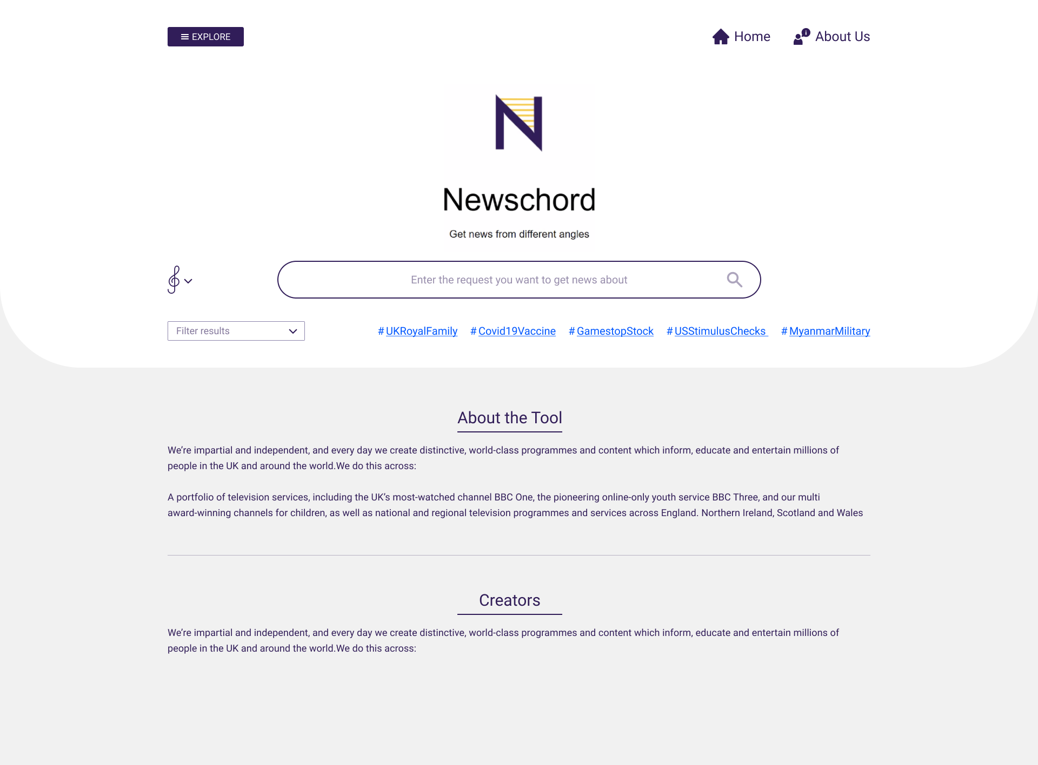
1
3
2
Notes:
In its infancy, NewsChord is a website that acts as a search engine for sensitive news. Upon arriving to the site, this is the page first rendered. Users have the option to digging for a headline via our “explore” menu, select a trending quick search headline or directly search a headline themselves

Slide 6
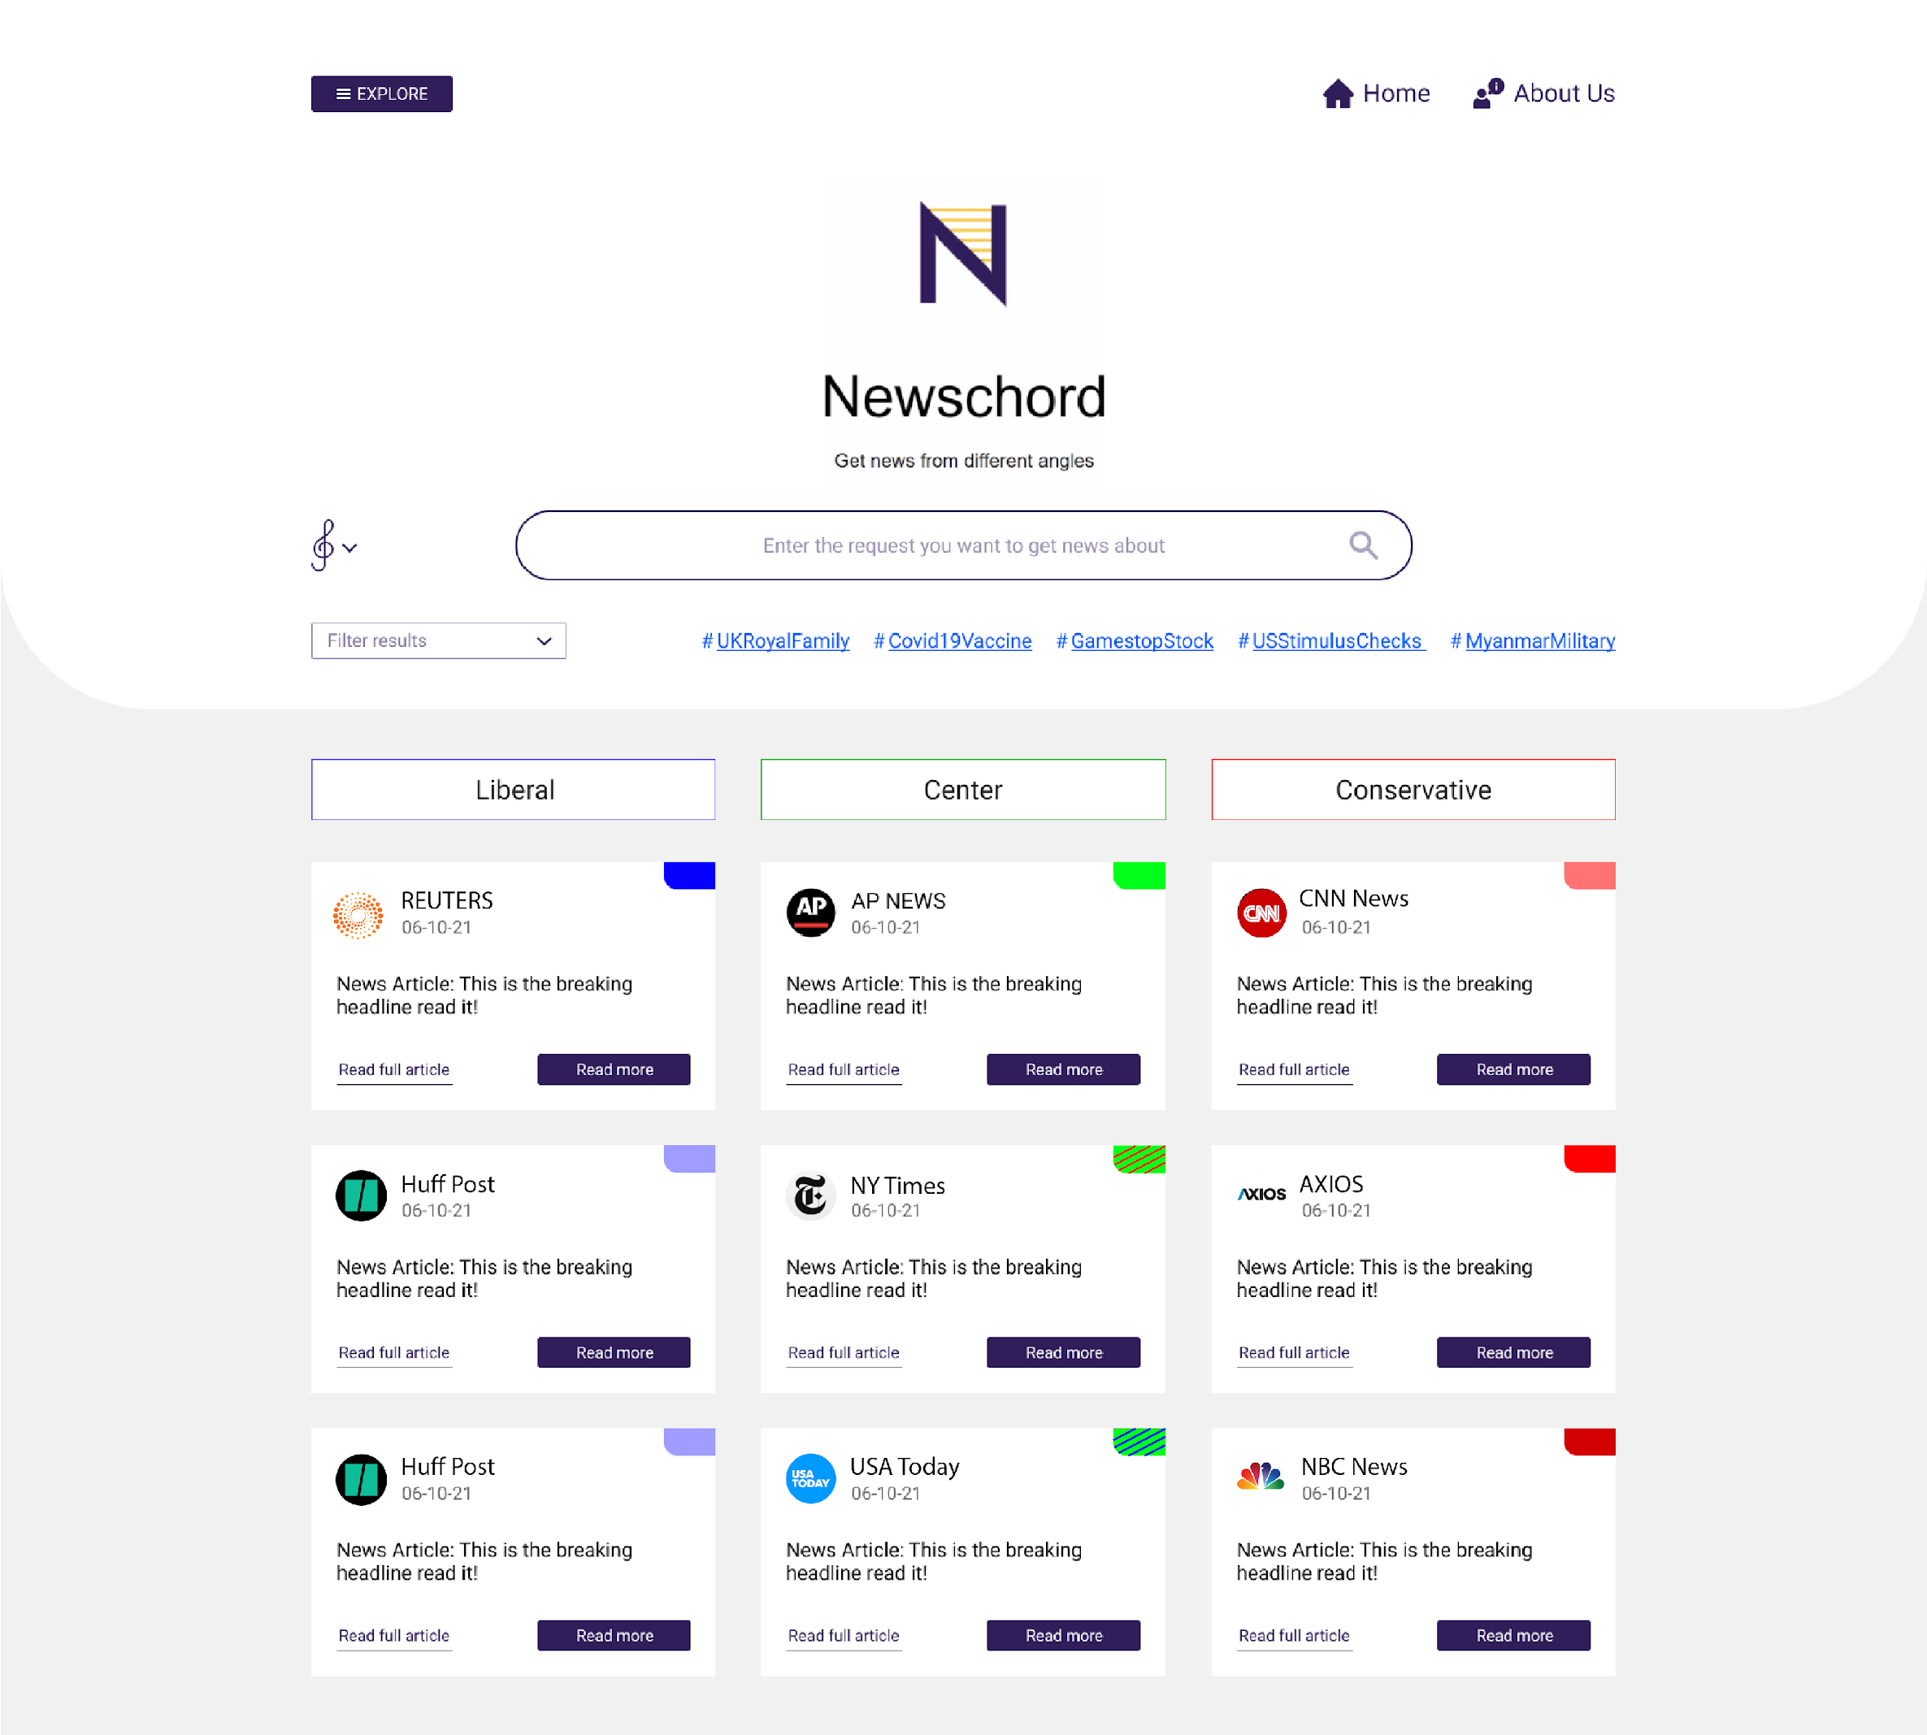
*
Notes:
The output of a search is a table format organizing various articles from various sources. Allowing users to see the spread of coverage. By-default articles that are depicted in each column are the most popular articles on that headline. However, there is are alot of customized search options available via the filter menu. Where the organization and filtering of articles can be tweaked.

Slide 7
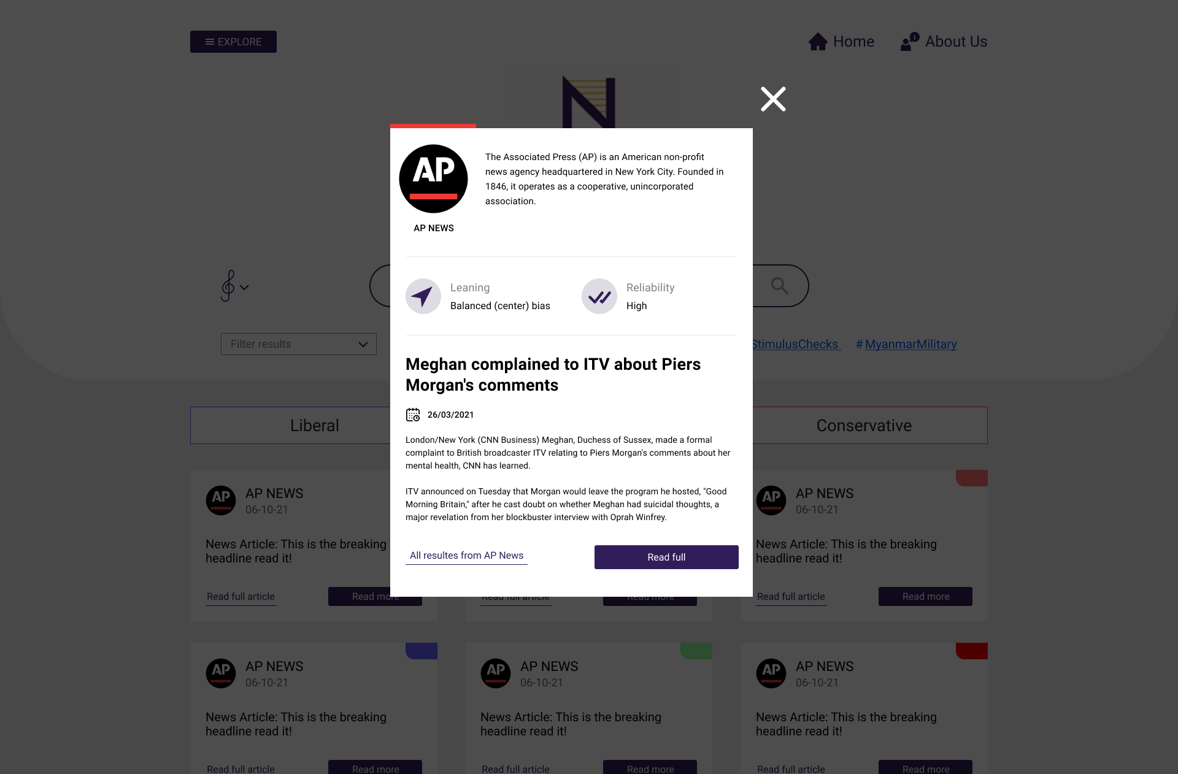
Notes:
For each article, User can open up a pop-up menu. The pop-up will provide additional information about the news source and the article. Moreover, see in-depth stats and ratings of leaning and reliability. These ratings are an aggregate of news source data created by media research organizations which is combined with machine learning analysis of the article itself.
If forced to simplify ourselves to look for competitors, NewsChord is a google search bar for news

Slide 8
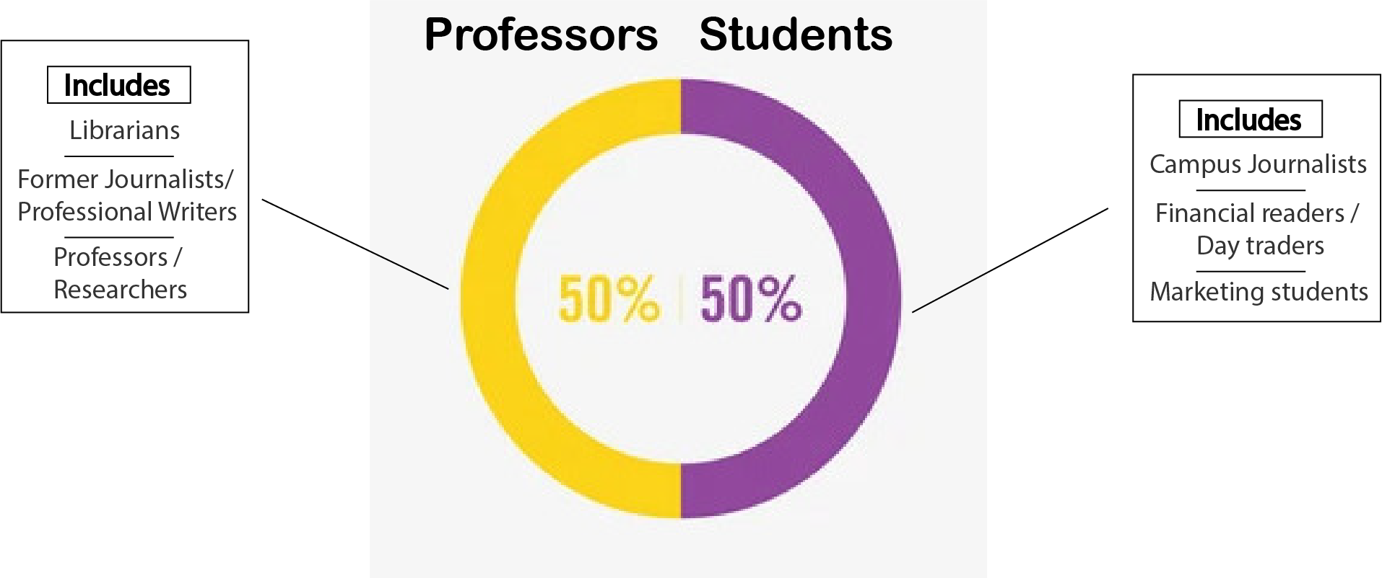
Target Market and Opportunity
Our target market is a term we call the “educated news reader”.
Our early adopters will be die-hard “educated news readers”
They care about where their news comes from. Reputable sources instead of reading news from facebook
They usually go the extra step and research to find out the unbiased truth story behind a headline
They aren’t glued to a specific news source
They hate having to do the manual research themselves and are skeptical about trusting a single source
Target market
Can be anyone that reads the news from the internet in the manner of an “educated news reader”
Estimate quantification: In the USA (our initial market) 86% of people read news online. Crossed with 30% of americans who hold a bachelor degree (“educated news readers”). Our rough low-balled market in the USA is 15% of the population, roughly 50 million people.
Intended initial market: University atmosphere, news analysts, schools teachers that give “news reading assignments”, and similar personas. Market validated by talking to 20 potential users within a university atmosphere. Consisted of 10 professors and 10 students.
Opportunity:
This is the best time for an idea for NewsChord given that the dangers of sticking to a single source of information were made evident to everyone during the COVID19 pandemic, racial unrest movements, and events surrounded the presidential election. During these major events, there was so much polarization in the news outlets that to the avid news reader a need for a source of balanced information was made very clear. And this need is addressed by NewsChord

Slide 9

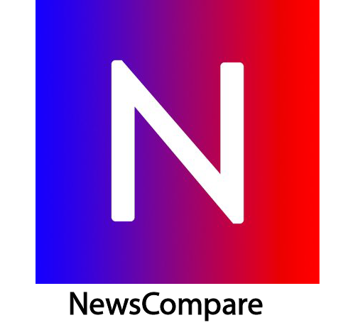


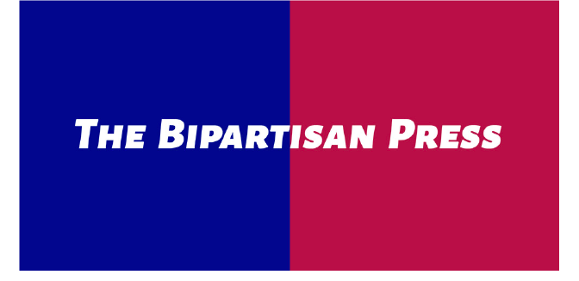
Competitors
Competitor shortcomings:
Poor User Interface
Poor User experience
Not Intuitive for users
Product/site doesn’t solve the root problem,
NewsChord’s speciality:
“Finding News by Headline”
Organizational focus of EASING news article searching and reading
All of our direct competitors are smaller companies. There are no big players tackling this problem

Slide 10
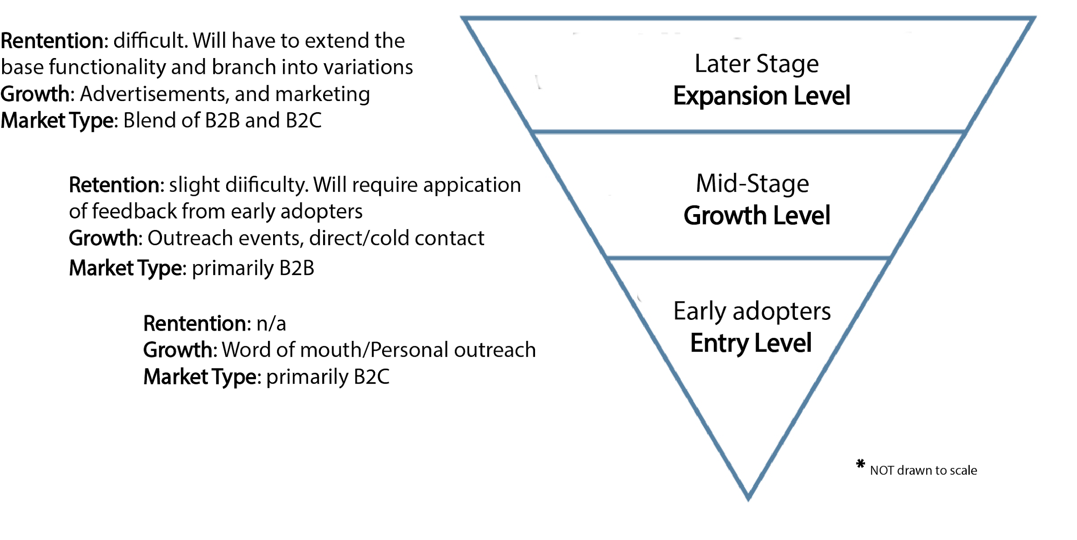
Marketing and Sales Strategy
Market Segmentation
Our biggest advantage in marketing is being college students. We will use this as leverage to market our product in the initial stages. From there we can reach out to professore and attend events on campus to increase marketing. Once a strong enough following has been established our marketing will be tailored to user retention through the use of surprising customers with free gifts or discounts and address customer complaints in a time effective manner.

Slide 11

Revenue models and Business models
Free User - Ads
I.e. Native ads, Corporate and Social responsibility(CSR) ads
Ads will be enough to sustain 100% NewsChord’s fixed costs
Paid User – Paid subscription
Benefits: advanced features
Target: organizations and Individuals
Individual pricing: starting $5 per user
Freemium
NewsChord’s Benefit: As a web business we have the benefits of high scalability and potential for high profitability

Slide 12
Financials and Projections
Costs
Fixed expenses are for hosting, domain fees, and etc. They total out to $200 annually ($10/month for hosting, $20/year for the domain and etc..)
Variable costs are for licensing, web infrastructure, and etc.. They are estimated to be $4 per user. These numbers represent initial startup and will decrease as our company ages.
Projections for annual revenue can’t be fully determined as profit depends on traffic to the site and number of user subscriptions. However estimated projections are…...
Our initial estimated freemium conversion rate is 5%, while our monetization through ads is $3 per thousand visits. Assuming 1 million unique users and 75 million site visits for a projected year 2 (numbers estimated modestly from growth of Axios). Our revenue would be would be $500,000.Projected average monthly user growth rate is modest 10-20%.

Slide 13
Current traction & Use of Funds
Current traction:
Own the domain name
Have a basic website framework with basic functionality.
Have proof of concept and compilation of feedback on this proof of concept
Funds to start our idea:
Hire software engineers to help with development of the website and infrastructure.
Reach out to more users via outreach
Increase server capacity/functionality for the growing client base.
more….

Slide 14
The End
WE CAN EASE YOUR ONLINE NEWS READING

